Slide 1
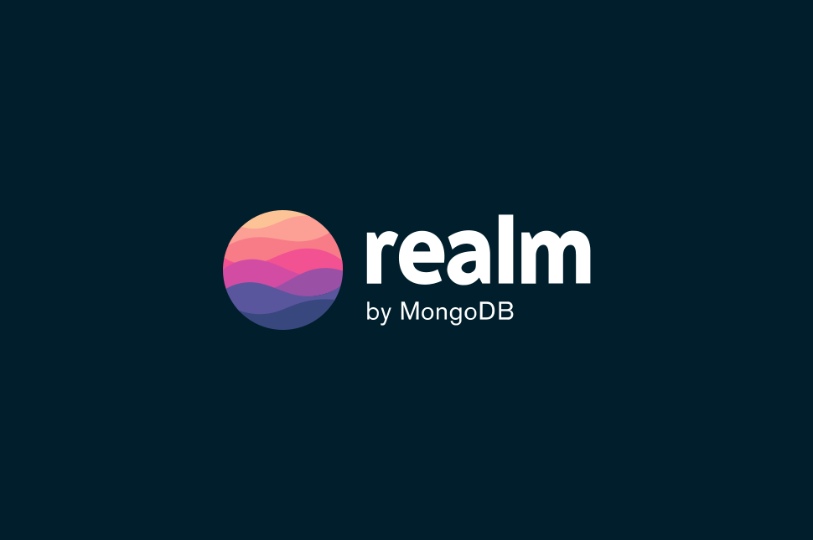

Slide 2
Index
Introduction to realm.
Why Realm.
Application Architecture Without Realm.
Realm Architecture.
How realm works.
Types of sync offered by realm.
Prerequisites.

Slide 3
Introduction to Realm
MongoDB Realm is a mobile-first database that is designed for modern, data-driven applications. It is a Fully managed mobile database platform provided by mongoDB, that enables developers to build applications with real-time synchronization.
(Synchronization is a process of ensuring that multiple copies of data are kept consistent
and up-to-date accress different system devices)
Key features-
Real-Time Sync.
Robust user authentication and authorization.
Secured- AES256 Encryption.
Supports cross-platform development.
Supports JSON.

Slide 4
Realm SDKs integrates with MongoDB Atlas and Atlas app services like Device Sync.
MongoDB Atlas- A cloud-hosted database service that provides a managed experience for MongoDB.
Atlas Device Sync- It is a cloud-to-edge sync service that allows mobile apps to keep their data synchronized across multiple devices, even when offline.

Slide 5
Why Realm
Feature | Applications with Realm | Applications without Realm
Performance | Very Fast | Comparatively slow
Simplicity | No Need to learn SQL | Need to learn SQL
Offline Support | Yes | No, or Limited
Features | Live Queries, change tracking, built in security and more | Limited set of features

Slide 6
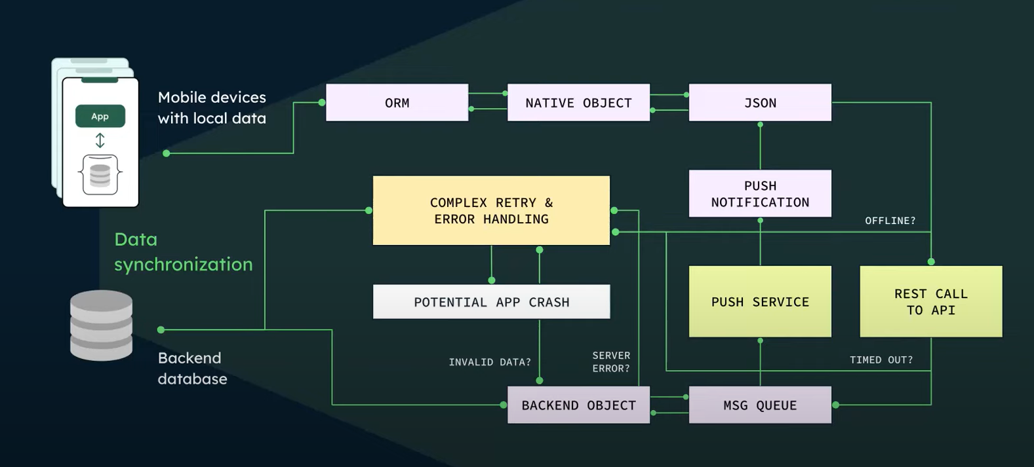
Application Architecture Without Realm

Slide 7
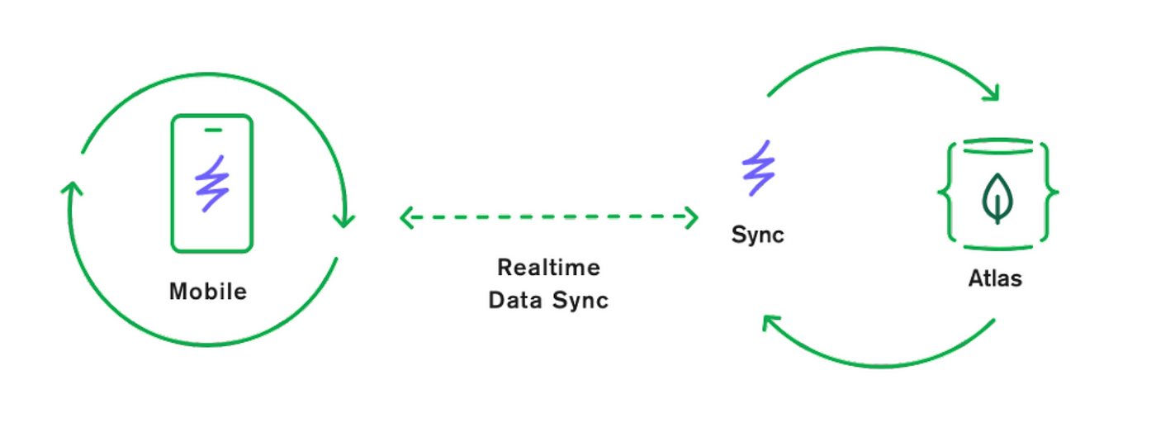
Basic Overview Of Realm

Slide 8

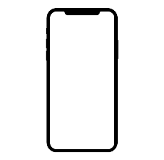

Realm Architecture
Realm services
Functions
Device Sync
Realm SDK
Triggers
Data Access Rules
Atlas Storage
Authentication

Slide 9
Working- Push changes to mongoDB
As the user makes Edit, it commits that transaction locally from there in background thread.
The realm synchronization thread automatically sees that and it has connection to the backend to device sync.
It replicates that operation to the device sync.
Translates that into a mongoDB API command (mql command).
Insert that document model into altas.

Slide 10
Working- Pull changes From mongoDB
If another user inserting a different document but that one needed to flow down to the client.
The device sync sees that, it sees that it should be synced down to clients.
It automatically picks up that document.
Convert into the realm operation.
Sync and pushes down to the clients.
The client first receives that operation applies it to its local state on disk
Realm SDK has notification API that fires and allow developer to update the UI.

Slide 11
Realm offers Two types of sync-
Flexible sync- Allows you to synchronize data between client (such as mobile device) and server (Realm server).
Use Case: Designed to synchronize a large, shared dataset across multiple clients.
Key features-
Schema changes.
Automatic conflict Resolution.
Scalability.
Partition Sync- Allows you to synchronize a specific subset or partition of data between client and server.
Use Case: It's particularly useful for applications where different clients work with different subsets of data.
Key features-
Focused Data Sync.
Fine-Grained Control.
Reduced Bandwidth Usage.

Slide 12
Prerequisites
An App Services App
Flexible Sync enabled with Development Mode

Slide 13
----- Thank You -----

